Slide 1

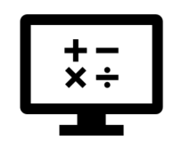
Fundamentals
Where do I find MATLAB? Here!
Do I have to have MATLAB installed on my computer right now? No, you can use MATLAB Online!

Slide 2

Table of Contents
What is Programming? What we've covered this week in Part 1
MATLAB Live Script

Slide 3
What is Programming?
Programming is the process of creating a set of instructions that tell a computer how to perform a task. Programming can be done using a variety of computer programming languages, in this course we’ll be using the MATLAB programming language.
An example of this task could be something as simple as calculating the volume of a cone or as complex as finding the shortest path between two cities. Programming helps us solve these tasks or problems in a logical and creative way.
Programming allows you to improve your problem-solving skills and as we know this is a critical skill to have as an engineer, moreover it is an exciting skill that can broaden your career possibilities as an engineer as it can be used in various fields.
Computer programming is becoming more important in today’s world as everything around us requires it, it is part of our daily living even in the little things. With the number of problems in our world today and their increasing complexities, programming is a way to create innovative solutions by automating, collecting, managing, calculating, and analysing data and information accurately.

Slide 4
What is Programming?
In general, there are 4 steps you should always follow when designing a program:
Specification: The description of the task that should be executed by the program
Algorithm design: The method that will be used to execute the task must be designed so that the program adheres to the specification
Coding of the algorithm: The algorithm must be written in a programming language that can be executed by the computer.
Execution: The program must be executed with a set of examples that reasonably cover all the possible cases of data input. If the program does not work properly, the algorithm will have to be redesigned.

Slide 5
What is Programming?
Let’s use these 4 steps for the cone volume example:
Specification:
Input – the program reads the given radius and height of the cone.
Output – the program calculates the volume of the cone, using the formula for a cone.
2. Algorithm design:
There are two common methods used to design/plan a program: using pseudocode or a flowchart.
Pseudocode uses English statements that describe what a program is to accomplish, imitating real code. For our example, the pseudocode will look as follows:
input (radius, height)
volume = 1/3*3.14*r*r*h

Slide 6
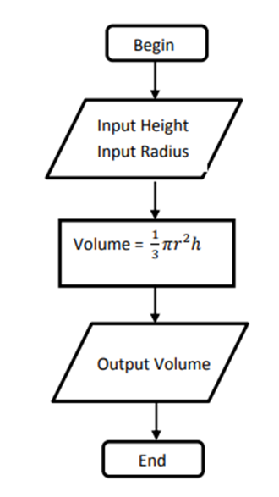
What is Programming?
A flow chart is a diagram that represents the workflow/process of a program, and in our example, it would look as follows:

Slide 7

What is Programming?
3. Coding of the algorithm:
As mentioned previously, we’ll be using the MATLAB language in this course, the code will look as follows
(Run the code below using the Run Section button, ):
%The answer should be 1206.4
radius = 8 %cm
height = 18 %cm
volume = 1/3*pi*radius*radius*height

Slide 8

What is Programming?
Step 4 would use a few values of radius and height, enter values of your choice and check with a calculator whether your answers match:
radius_1 = %cm
height_1 = %cm
volume = 1/3*pi*radius_1*radius_1*height_1
Now you try! Write pseudocode for calculating area of a circle below:
Later we’ll see how we write the MATLAB code for the area of a circle in Mathematical Functions.

Slide 9
What we've covered this week in Part 1
This week in Part 1 we learnt about:
What programming is

Slide 10
MATLAB Live Script
Click on the link below for this lecture’s MATLAB live Script
Week_1_Part_1_Fundamentals.mlx
Copyright 2022 The MathWorks, Inc. & Opti-Num Solutions (Pty) Ltd.

